Slide 1
Facebook Donor Guide:
How to spread the word on Facebook that you are a MCUW Donor

Slide 2
Spread the Word
Thank you for your
commitment to MCUW!
As a donor you are making a great impact in the community
Use Facebook to show how you are giving back
Follow these quick and easy steps or do your own thing
If you need any assistance please contact Meghann Boser
Contact Info: 320-632-5102 or mcuw68@gmail.com
3 optional phases available here with examples:
(your business name will appear on the top of the post)
Campaign Kickoff
Campaign In-Progress
Giving All Year

Slide 3
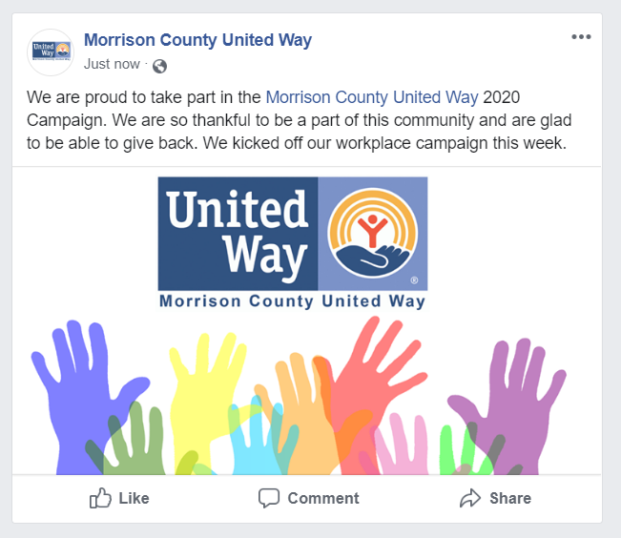
Facebook Post – Campaign Kickoff
Schedule: September 16th – September 19th
Donor Text (or use your own):
We are proud to take part in the @Morrison County United Way 2021 Campaign. We are so thankful to be a part of this community and are glad to be able to give back. We kicked off our workplace campaign this week.
Choose your image from the Business Tool Kit
***Tip: be sure to put your cursor behind the @Morrison County United Way and then choose Morrison County United Way from the tag drop down box, that will tag Morrison County United Way so that the reader can connect the post with the organization.***

Slide 4
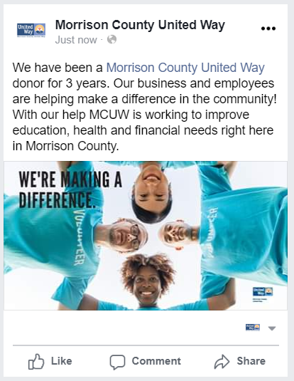
Facebook Post – Campaign In Progress
Schedule: Start after September 19th and run a few times before December 31st
Donor Text (or use your own):
We have been a @Morrison County United Way donor for ______ years. Our business and employees are helping make a difference in the community! With our help MCUW is working to improve education, health and financial needs right here in Morrison County.
Choose your image from the Business Tool Kit
***Tip: be sure to put your cursor behind the @Morrison County United Way and then choose Morrison County United Way from the tag drop down box, that will tag Morrison County United Way so that the reader can connect the post with the organization.***

Slide 5
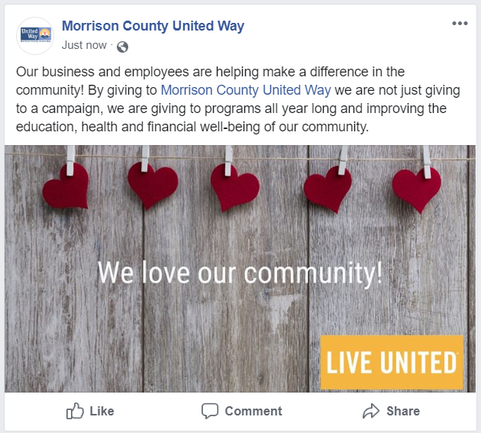
Facebook Post – Giving All Year
Schedule: Have fun with this one and run it whenever you want
Donor Text (or use your own):
Our business and employees are helping make a difference in the community! By giving to @Morrison County United Way we are not just giving to a campaign, we are giving to programs all year long and improving the education, health and financial well-being of our community.
Choose your image from the Business Tool Kit
***Tip: be sure to put your cursor behind the @Morrison County United Way and then choose Morrison County United Way from the tag drop down box, that will tag Morrison County United Way so that the reader can connect the post with the organization.***

